Slide 2

Characteristics of satan
The Devil – Matthew 4:1
DIABOLOS {DEE-AB'-OL-OS}; a traducer {one who exposes others to shame or blame by means of falsehood and misrepresentation; a violator or betrayer}; specially, Satan: -false accuser,...slanderer."

Slide 3
Characteristics of satan
Satan – Found in Old Testament
SATAN {SAW-TAWN'}; an opponent; especially (with the article prefixed) Satan, the arch-enemy of good: -adversary,...withstand." In the New Testament, the Greek word is "SATANAS {SAT-AN-AS'}; of Aramaic origin...; the accuser, i.e. the devil: -Satan.“
The Ruler or Prince of This World – John 12:31
Ephesians 2:2 “prince of the power of the air”
The Father of Lies – John 8:44 “he is a liar and the father of it.”

Slide 4

He has no forked tail!
No Burning Eyes!
No Red Suit!
No Pitchfork!

Slide 5
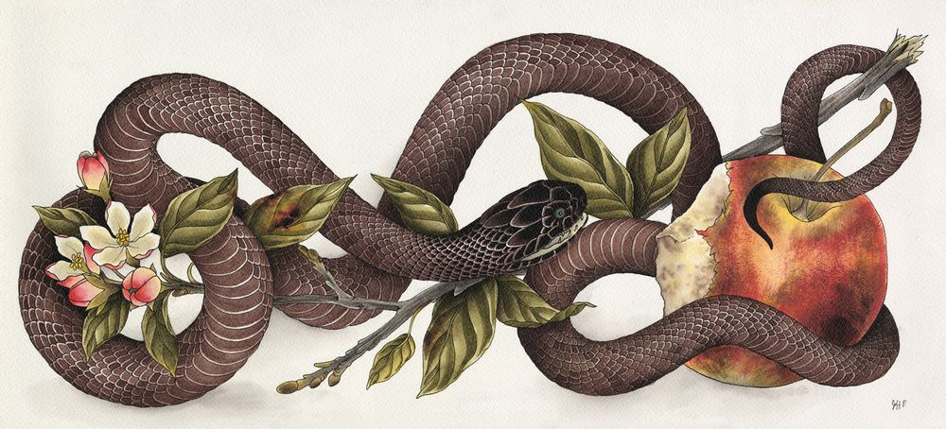
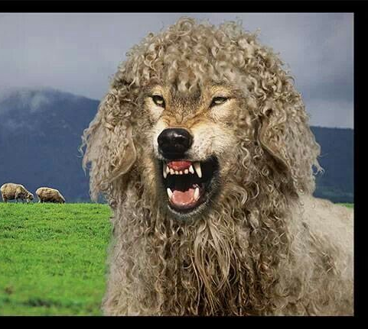

He uses disguises!
Serpent – Genesis 3
Wolf Dressed like a Lamb – Matthew 7:15
Transforms Into An Angel Of Light – 2 Corinthians 11:14,15

Slide 6

Vicious as a lion!
1 Peter 5:8
Smart – Wiles {tricks} of the devil – Ephesians 6:11
Romans 3:23 “all have sinned”
Luke 17:1 “impossible that no offenses should come”

Slide 7
Satan hates mankind!
Hated Adam & Eve:
Got them cast out of the Garden !
When they had children, the Devil influenced one to kill the other- John 8:44
He Hated Job:
Took away wealth, children & health
Job Chapters 1,2

Slide 8
Satan hates mankind!
Hated Peter:
Luke 22:31 “ Satan has asked for you, that he may sift {you} as wheat."
Peter Denied The Lord! Matthew 26:75
Satan Hated the Lord:
Christ came to save man from sin
Hebrews 2:18; 4:15

Slide 9
Satan hates mankind!
The Devil Hates YOU:
He will try to steal the word of God from your heart – Luke 8:12
Try to fill your heart with evil ideas!
Acts 5:3 “"Peter said, "Ananias, why has Satan filled your heart to lie to the Holy Spirit and keep back {part} of the price of the land for yourself?"

Slide 10
Blind men to the truth!
2 Corinthians 4:3,4 “the god of this age has blinded”
2 Corinthians 11:13-15
Appeal to Human Reasoning and various Prejudices –
Religion of Parent’s
Division In Religious World
Follow Blindly Religious Leaders
Lure away by Sinful Pleasures Of This World

Slide 11
Always tempts men to sin!
Started in the Garden- Genesis 3
Tried it with Jesus in the wilderness – Matthew 4
Still Working On Us Today!
James 1:13-15 “each one is tempted when he is drawn away by his own desires and enticed. (15) Then, when desire has conceived, it gives birth to sin; and sin, when it is full grown, brings forth death."

Slide 12
What can we do about satan?
2 Corinthians 2:11 “we are not ignorant of his devices.”
Resist Him – James 4:7 “Resist the devil and he will flee from you." 1 Peter 5:9
Ephesians 6:11-13 “put on the whole armor of God, that you may be able to stand against the wiles of the devil.”

Slide 13
What can we do about satan?
Watch and Avoid his Snares and Traps-
2 Timothy 2:24-26 “come to their senses {and escape} the snare of the devil”
If Overtaken – Flee To Christ
Acts 8:22 "Repent therefore of this your wickedness, and pray God if perhaps the thought of your heart may be forgiven you."
James 5:16 “pray for one another”

Slide 14
Christ came to destroy satan
Hebrews 2:14 “destroy him who had the power of death, that it, the devil…”
1 John 3:8 “might destroy the works of the devil."
God Is The Author Of All Good
Romans 6:23 “the gift of God {is} eternal life in Christ Jesus our Lord.“
You Don’t Want To Face The Eternal Destiny Of Satan – Matthew 25:41; Revelation 20:10,15

Slide 15
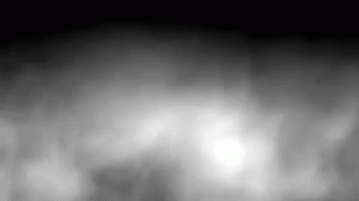
Don’t let satan throw his smoke screen over you

Slide 16

Come to the light of the glorious gospel of christ
NOW IS THE TIME!

